Slide 1
The Effect of Surfactant Partition Coefficient on Foam Transport
Yongchao Zeng, Kun Ma
2014.04.17

Slide 2
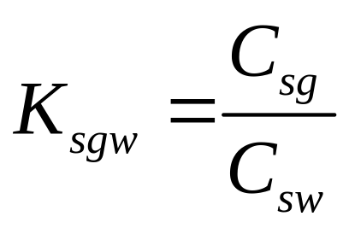
Surfactant for Foam Flooding
Anionic surfactants
do not partition into the gas phase
Non-ionic surfactants
CO₂ soluble
can partition into the CO₂ phase

Slide 3
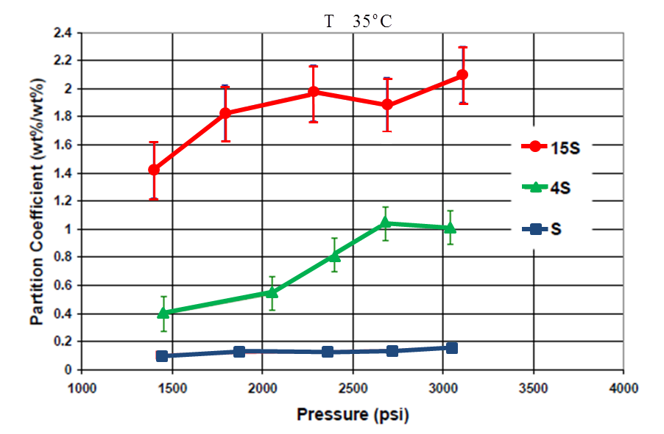
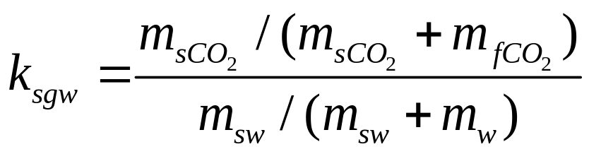
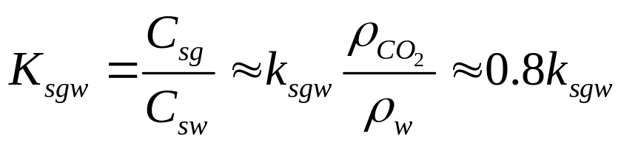
Surfactant Partition Coefficient
Characteristic Ksgw | value
Small | 0.05
Unity | 1.00
Large | 4.00
Ren, Guangwei, Hang Zhang, and Quoc P. Nguyen. “Effect of Surfactant Partitioning Between CO2 and Water on CO2 Mobility Control in Hydrocarbon Reservoirs.” SPE: Society of Petroleum Engineers, 2011. doi:10.2118/145102-MS.

Slide 4
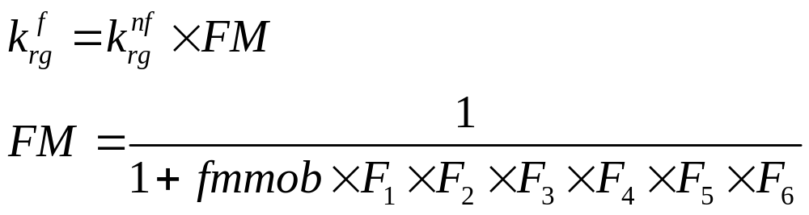
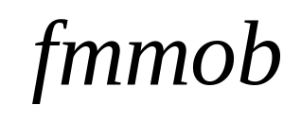
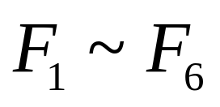
STARS Foam Model
The STARS Model
reference mobility reduction factor
contribution of different factors on
foam strength
Ma, Kun. (2013) "Transport of Surfactant and Foam in Porous Media for Enhanced Oil Recovery Processes." Doctoral Thesis, Rice University. http://hdl.handle.net/1911/71996.

Slide 5
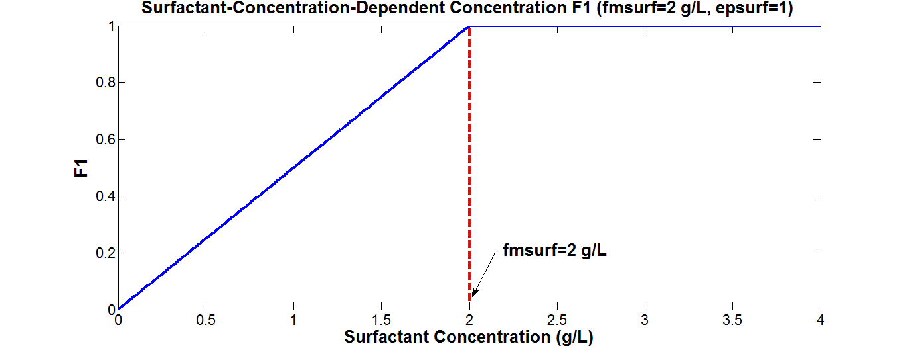
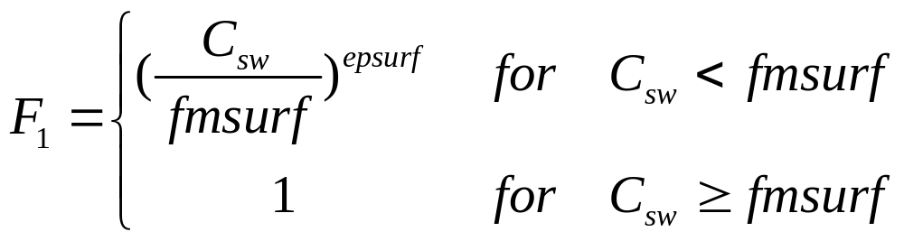
Surfactant-Concentration-Dependent function
Ma, Kun. (2013) "Transport of Surfactant and Foam in Porous Media for Enhanced Oil Recovery Processes." Doctoral Thesis, Rice University. http://hdl.handle.net/1911/71996.

Slide 6
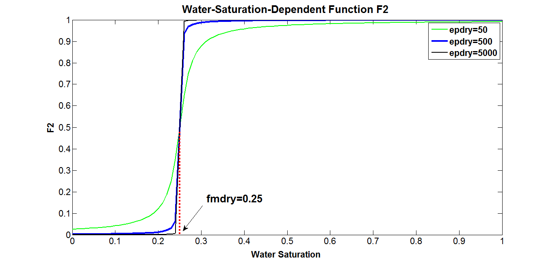
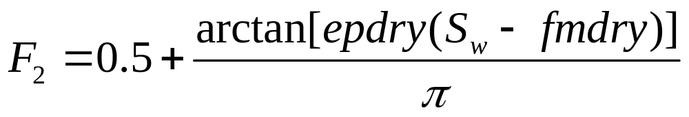
Water-Saturation-Dependent Function
Ma, Kun. (2013) "Transport of Surfactant and Foam in Porous Media for Enhanced Oil Recovery Processes." Doctoral Thesis, Rice University. http://hdl.handle.net/1911/71996.

Slide 7
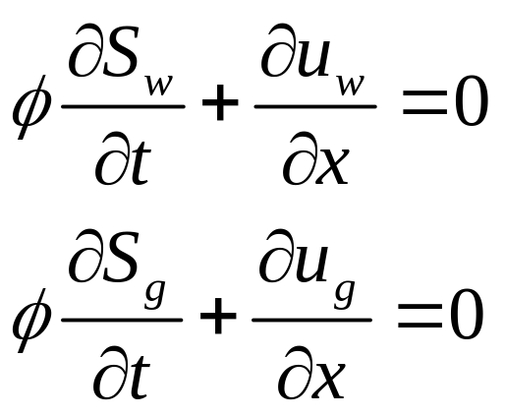
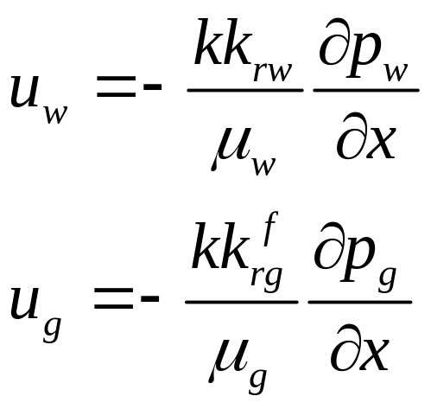
1-D Foam Simulator
Conservation of Mass
Conservation of Momentum: Darcy’s Law
Ma, Kun. (2013) "Transport of Surfactant and Foam in Porous Media for Enhanced Oil Recovery Processes." Doctoral Thesis, Rice University. http://hdl.handle.net/1911/71996.

Slide 8
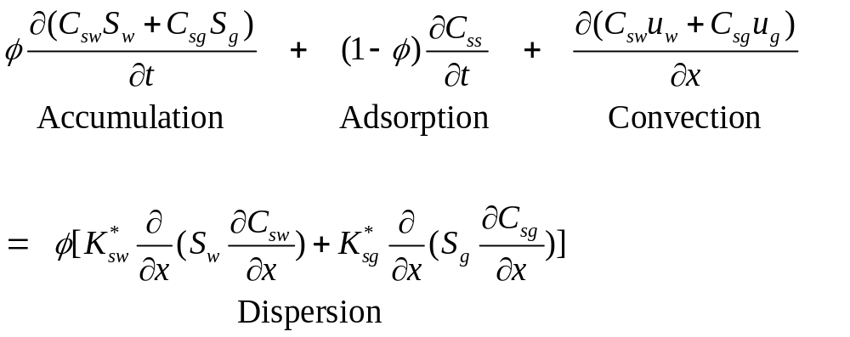
1-D Foam Simulator
Surfactant Partitioning
Ma, Kun. (2013) "Transport of Surfactant and Foam in Porous Media for Enhanced Oil Recovery Processes." Doctoral Thesis, Rice University. http://hdl.handle.net/1911/71996.

Slide 9
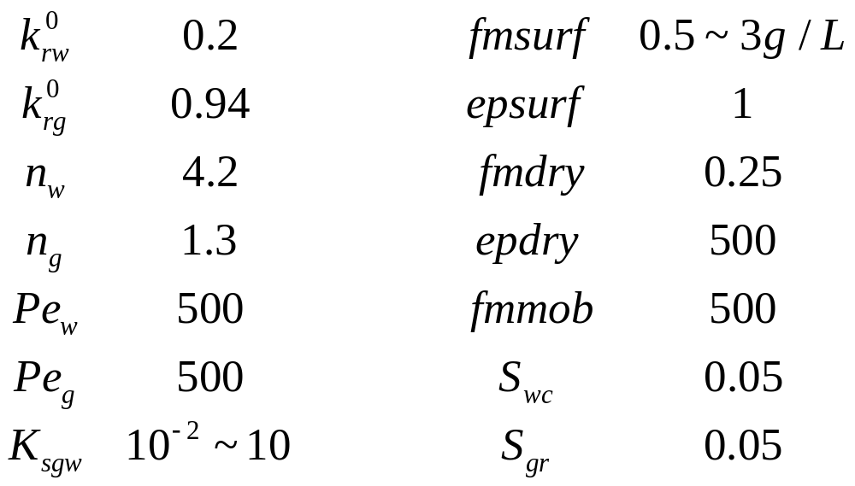
Important Parameters
Ma, Kun. (2013) "Transport of Surfactant and Foam in Porous Media for Enhanced Oil Recovery Processes." Doctoral Thesis, Rice University. http://hdl.handle.net/1911/71996.

Slide 10

Case Study
CO₂
&
Surfactant
MFC
$$∆P$$
20 ft/day
Brine
1 ft
Case I: CO₂ Displacing Water
Case II: Single Slug of CO₂ Followed by Water
Case III: Water Alternating Gas (WAG)

Slide 11
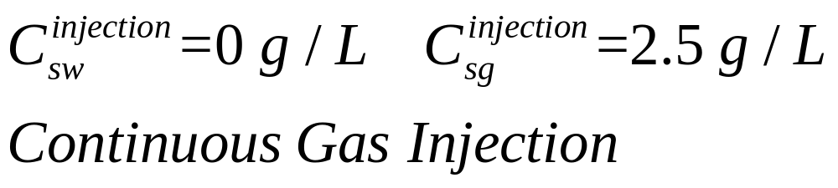
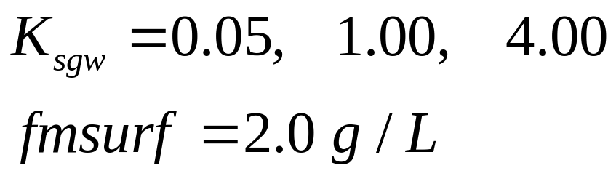
Case I: CO₂ Displacing Water
I.C.
1-D formation core saturated with water
B.C.
Parameter
Notes:
This cartoon shows how the pressure profile changes with time.

Slide 12
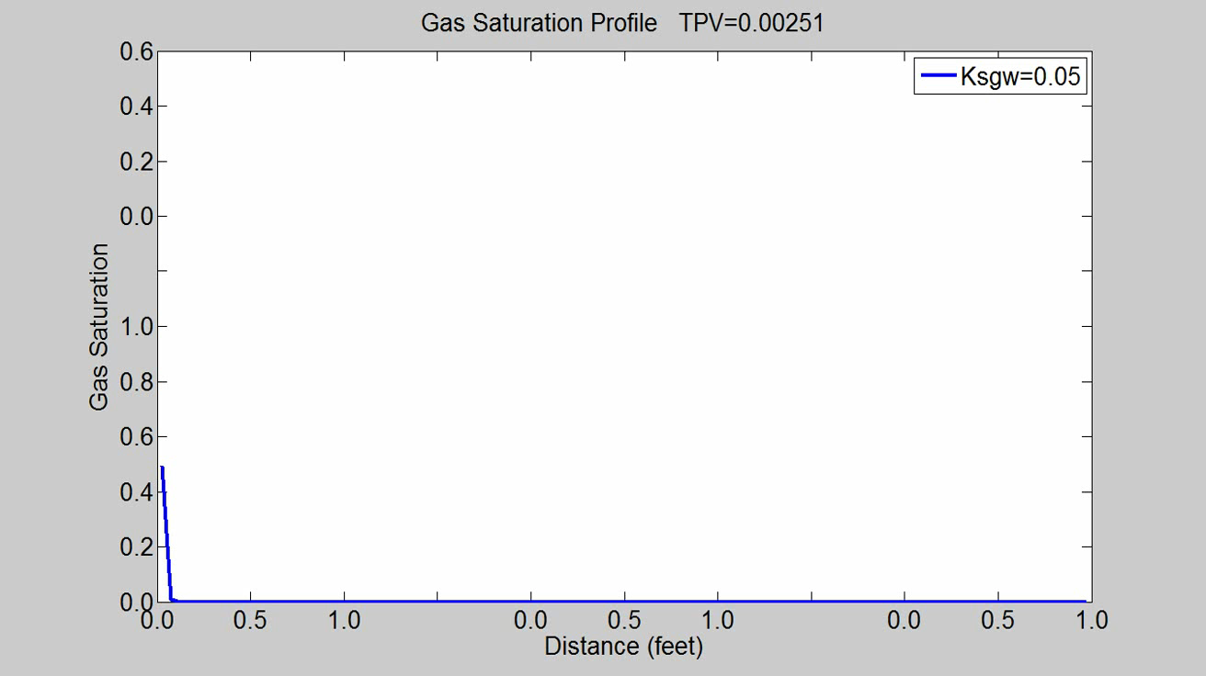
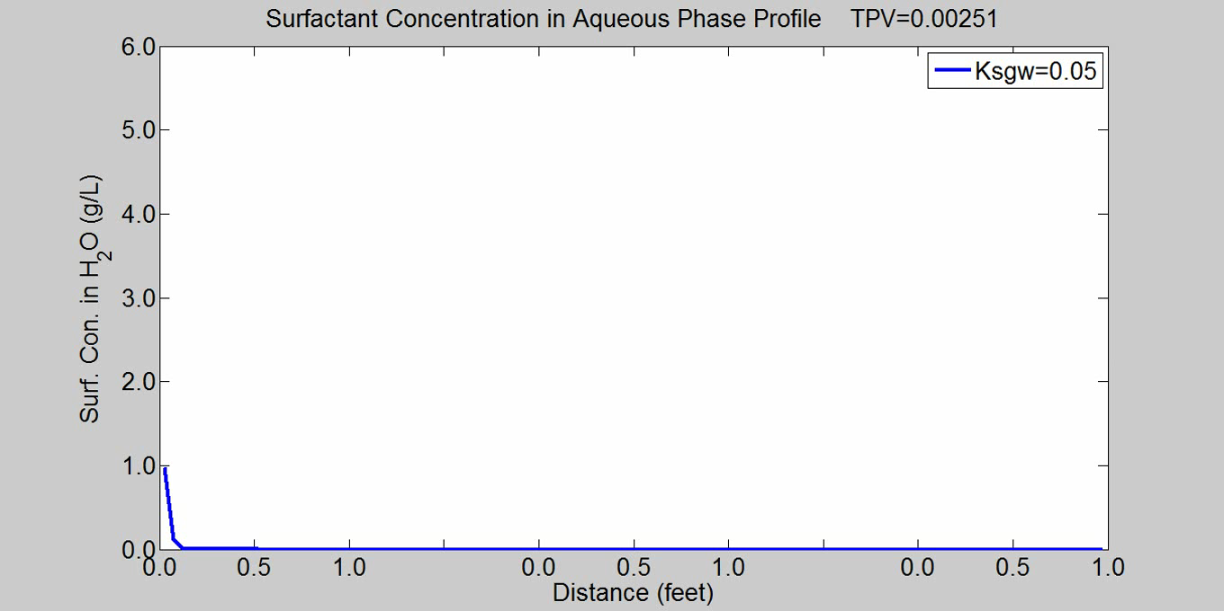
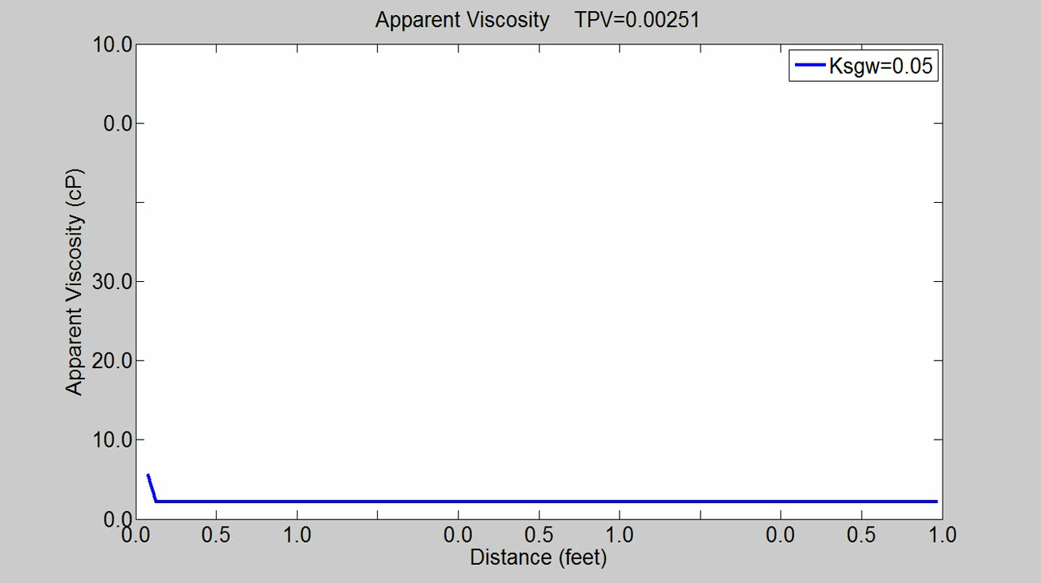

Slide 13
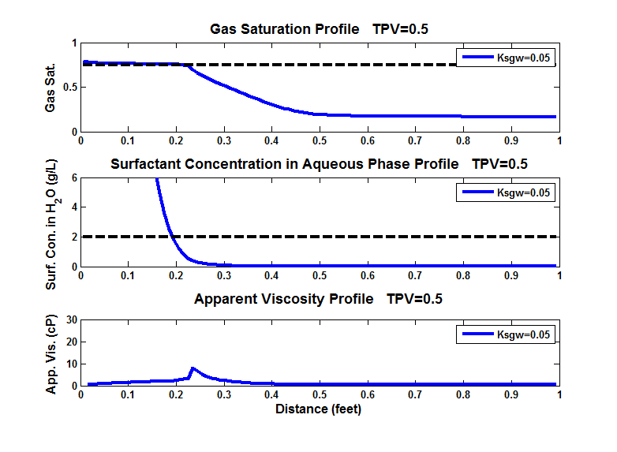
1-fmdry
fmsurf

Slide 14
Case I: CO₂ Displacing Water
Small partition coefficient (K_{sgw}=0.05):
Surfactant and foam transport will be strongly retarded.
Surfactant will be concentrated in a very small region near the inflow end. The concentration may exceed the solubility limit in water.
Foam is weak. Surfactant can be soon stripped off by water, gas mobility control is then lost. It will result in an very early gas breakthrough.

Slide 15
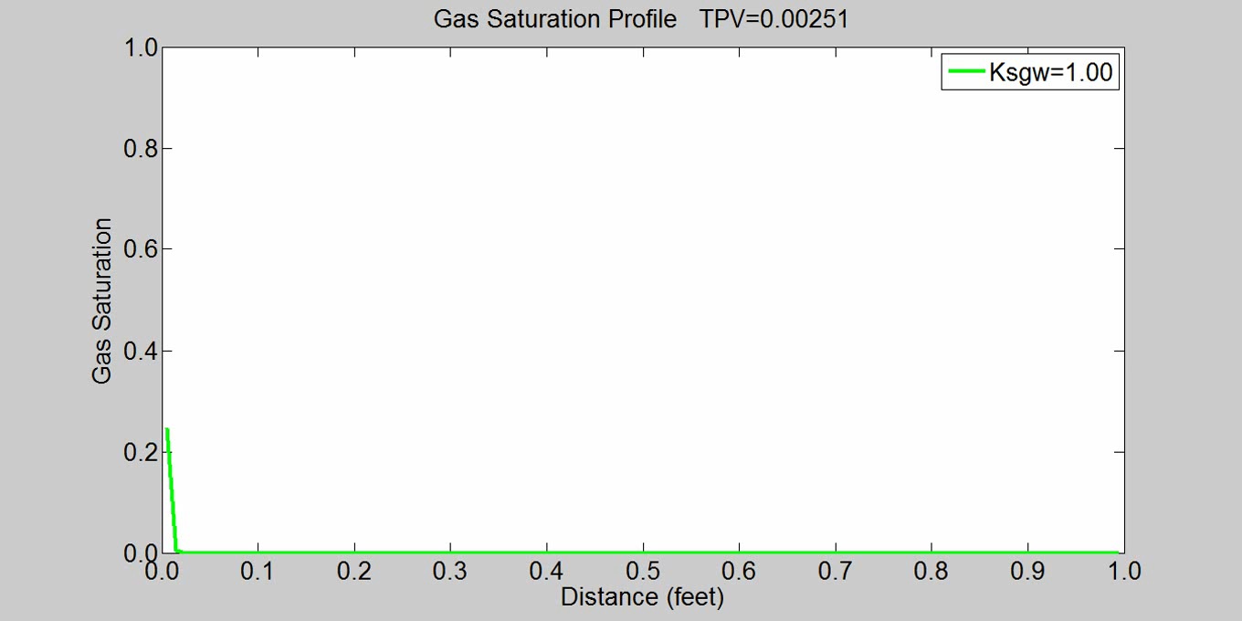
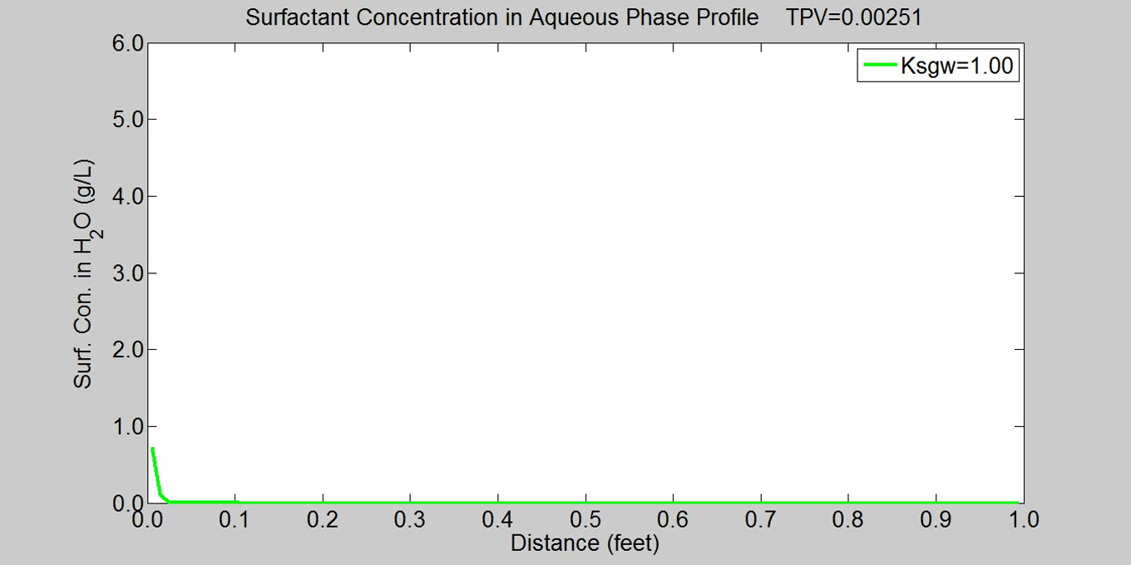
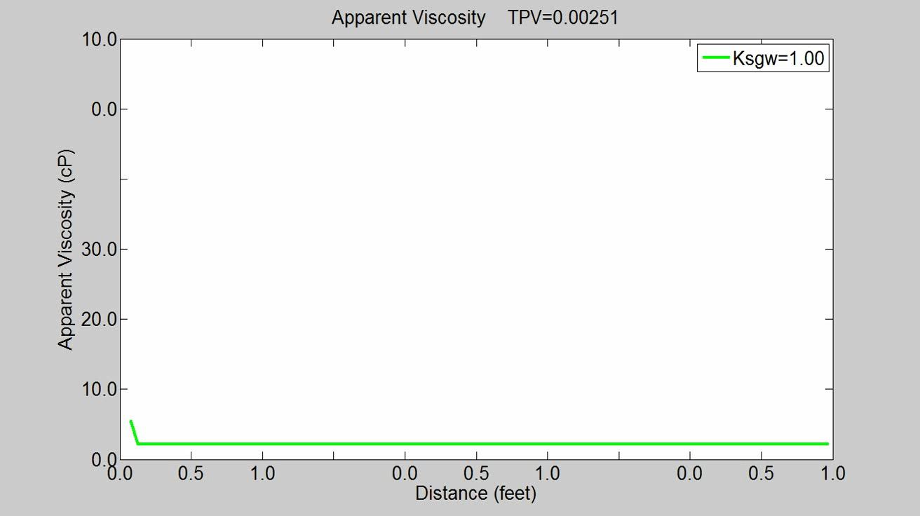

Slide 16
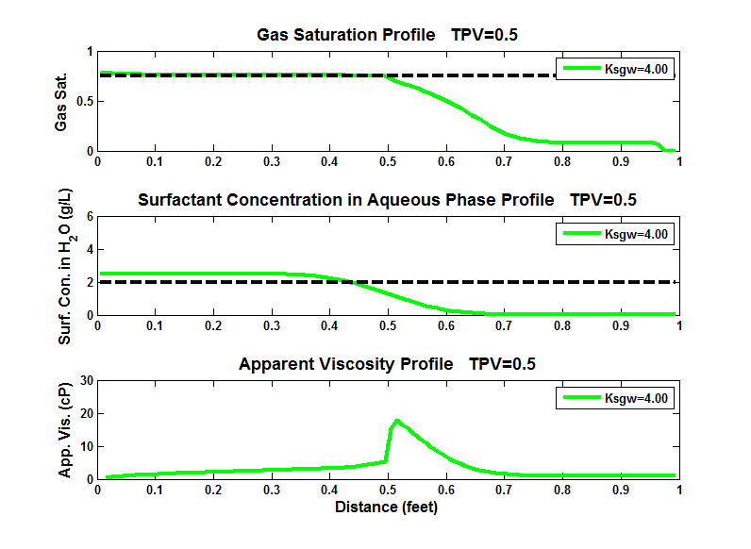
1-fmdry
fmsurf

Slide 17
Case I: CO₂ Displacing Water
Unity partition coefficient (Ksgw=1.00):
Surfactant transport is in accordance with gas front propagation.
Surfactant concentration in water is kept at around fmsurf.
Foam front is strong. However foam bank is relatively short due to dry-out effect.

Slide 18
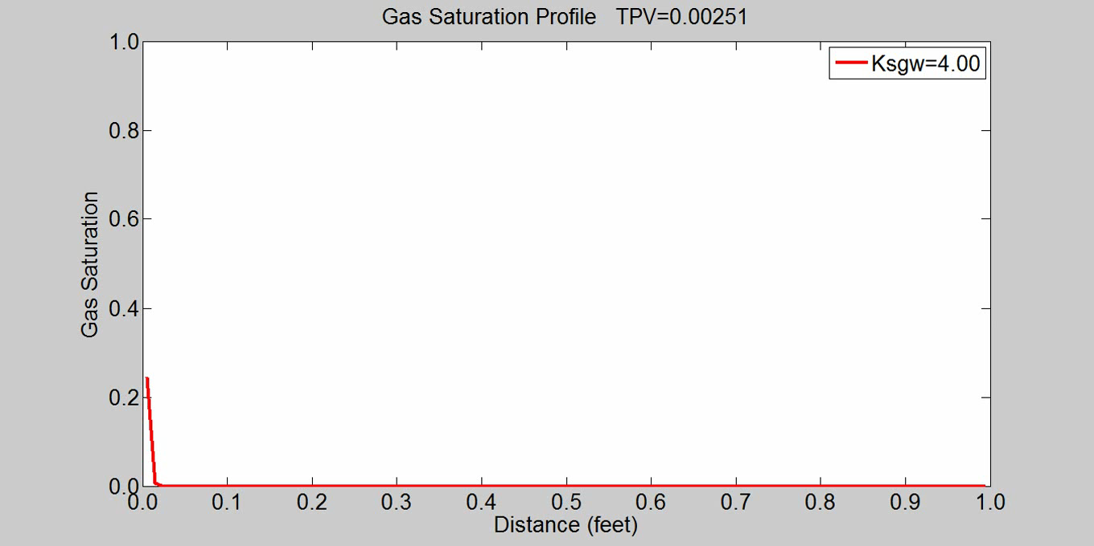
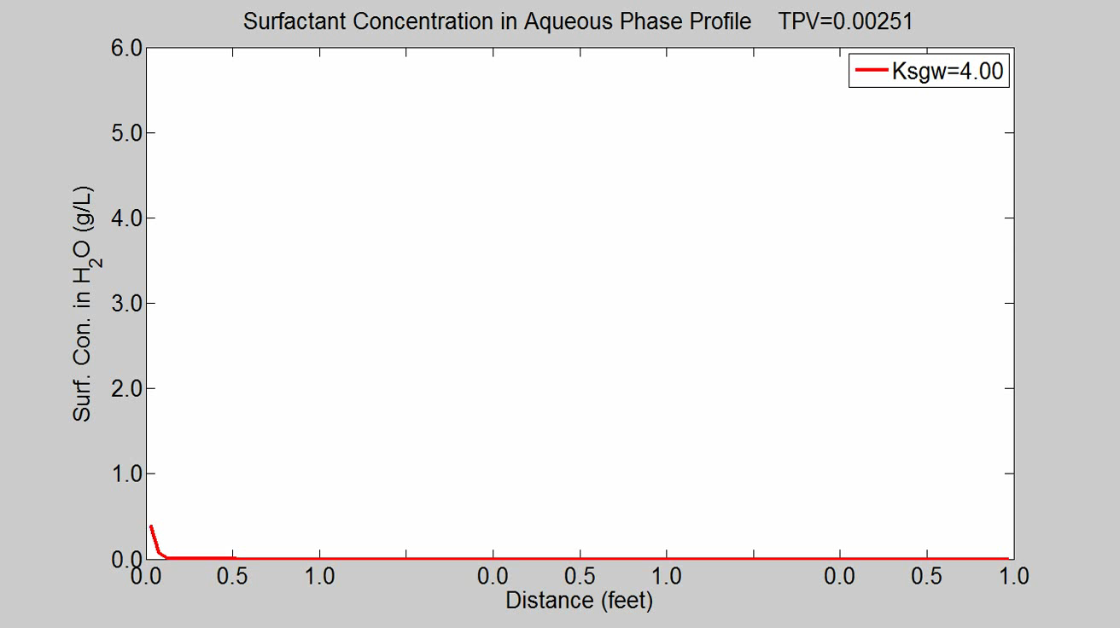
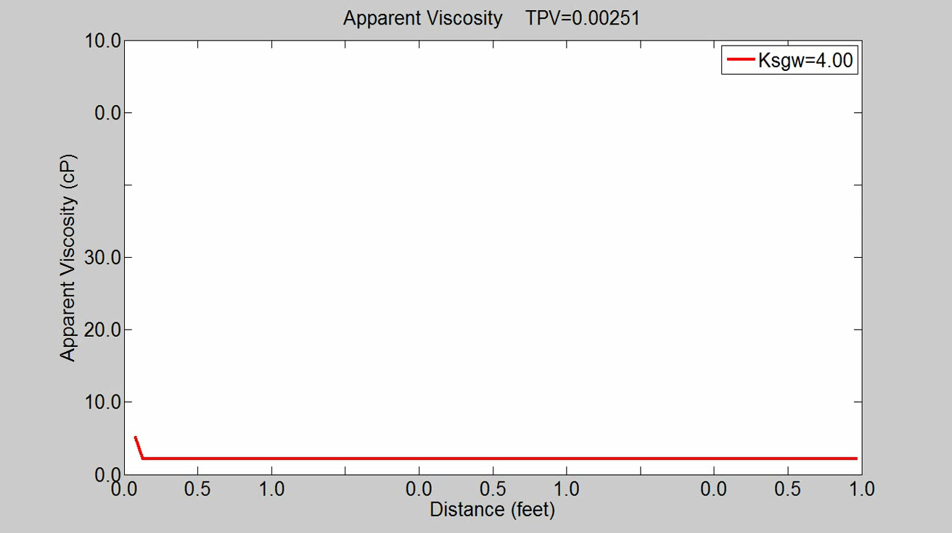

Slide 19
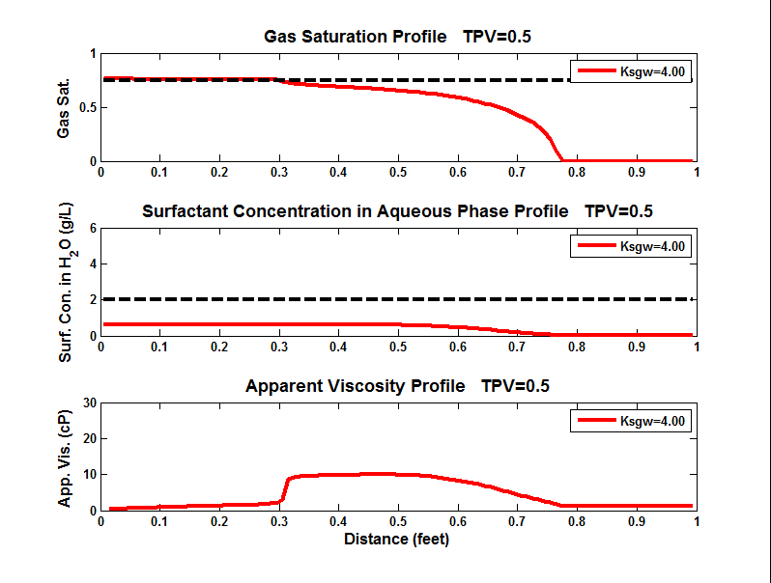
1-fmdry
fmsurf

Slide 20
Case I: CO₂ Displacing Water
Large partition coefficient (Ksgw=4.00):
Surfactant transport is in accordance with gas propagation.
Surfactant is highly spread out and the concentration in water is below fmsurf.
Foam front is not as strong as unity partition coefficient. However foam bank is largely elongated.

Slide 21
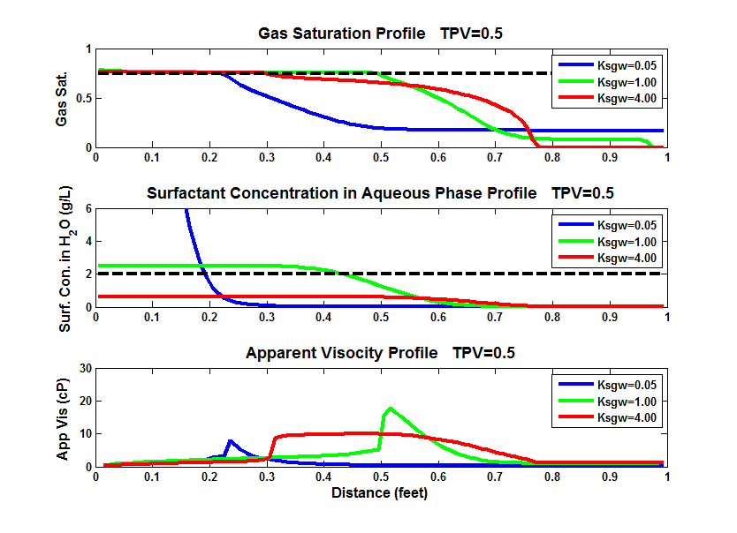
Case I: CO₂ Displacing Water
1-fmdry
fmsurf

Slide 22
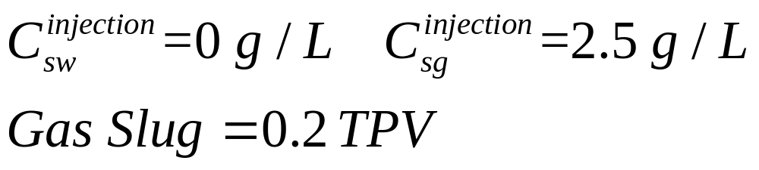
Case II: CO₂ Slug Followed by Water
I.C.
1-D formation core saturated with water
B.C.
Parameter
Notes:
This cartoon shows how the pressure profile changes with time.

Slide 23
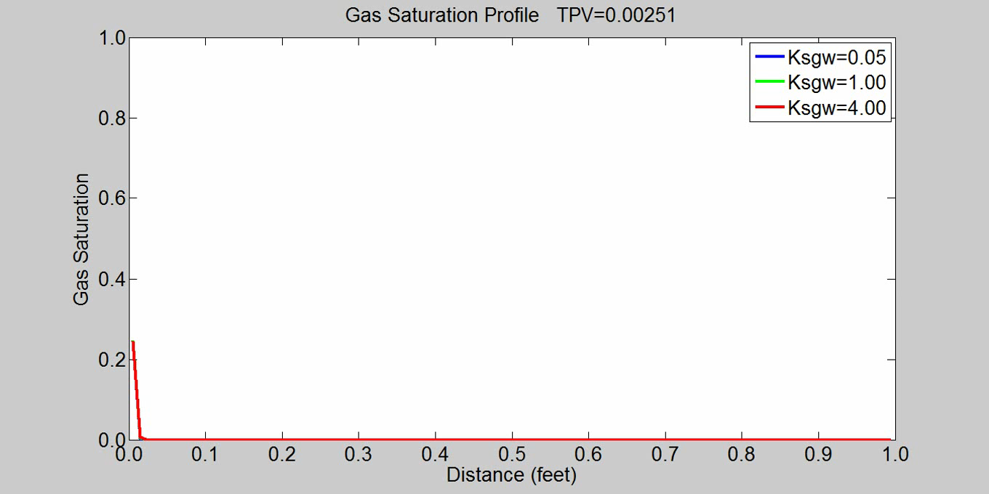
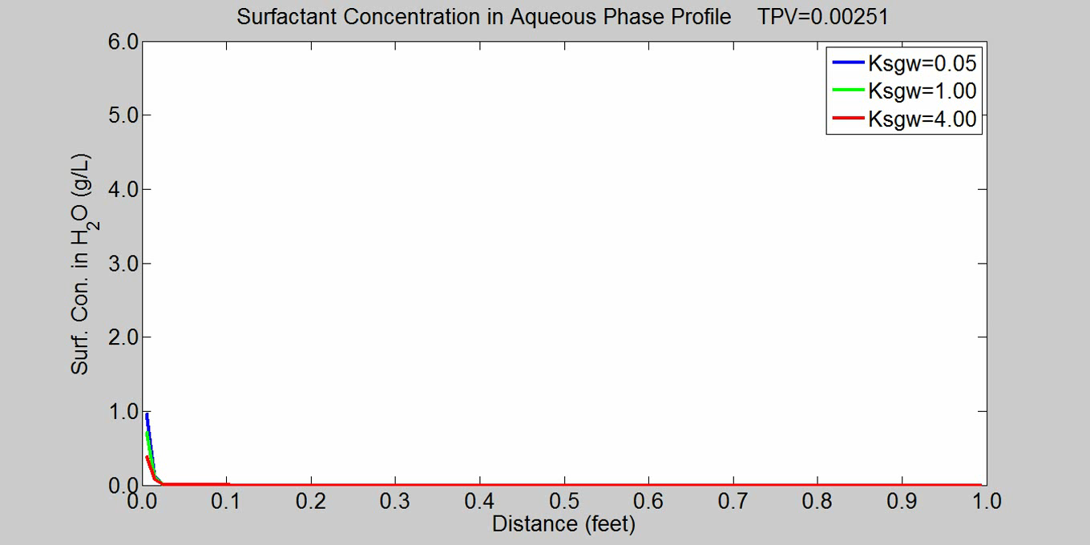
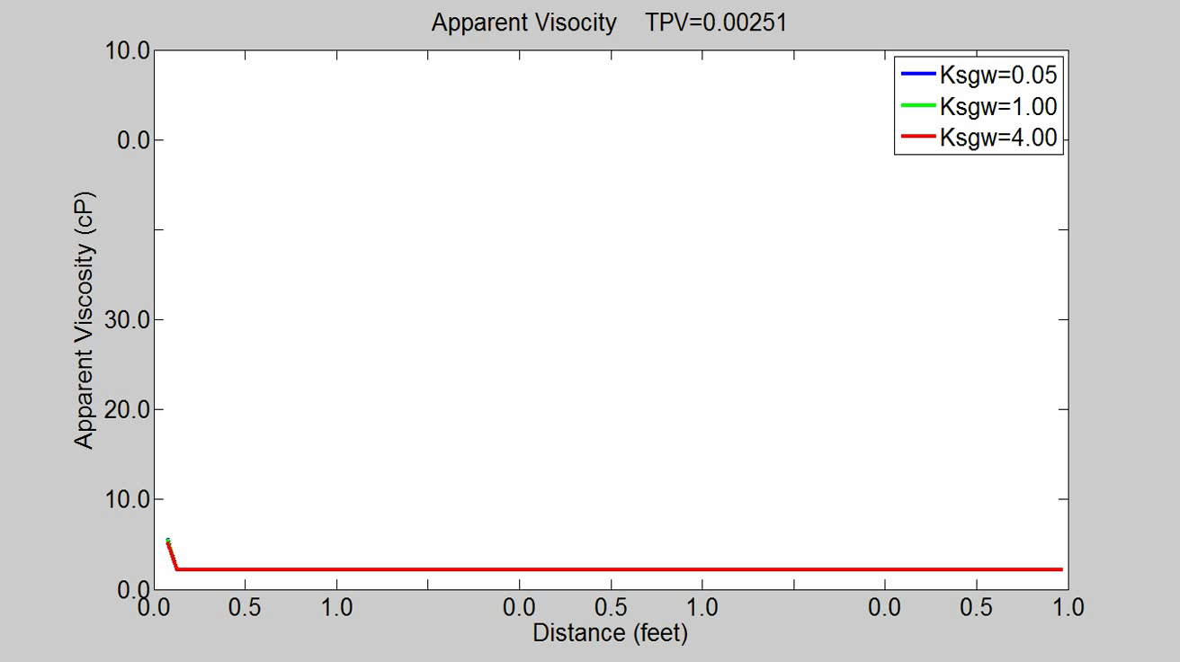

Slide 24
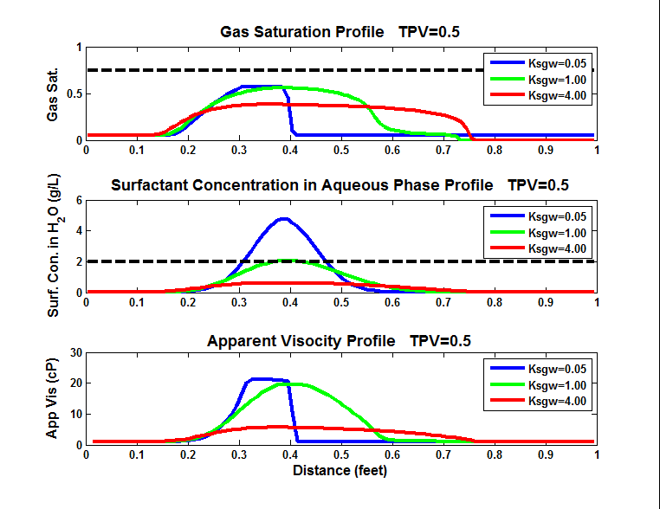
1-fmdry
fmsurf

Slide 25
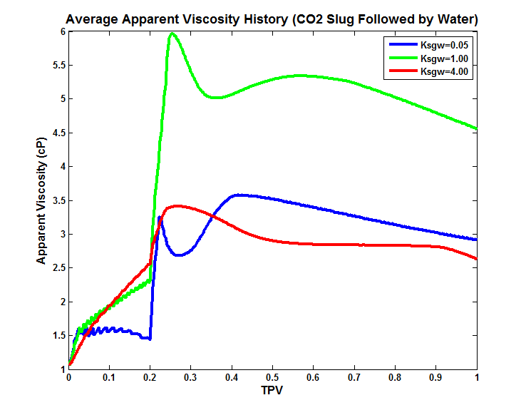

Slide 26
Effect of Water Slug after CO₂ Injection
K_{sgw}=0.05
  Water slug can dilute surfactant concentration near the inflow end and push the surfactant slug to move forward. However, the effect is limited and surfactant is still highly concentrated in a very small region. Foam is weak.
K_{sgw}=1.00
  Water injection can mitigate the dry-out effect right after the foam front and thus can elongate foam bank and increase the foam strength.
K_{sgw}=4.00
  Water injection will further dilute the surfactant concentration in water and weaken the foam strength.

Slide 27
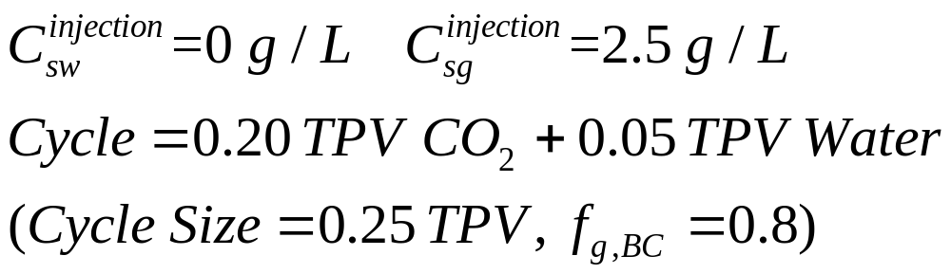
Case III: WAG—Surfactant Injected in CO₂
I.C.
1-D formation core saturated with water
B.C.
Parameter

Slide 28

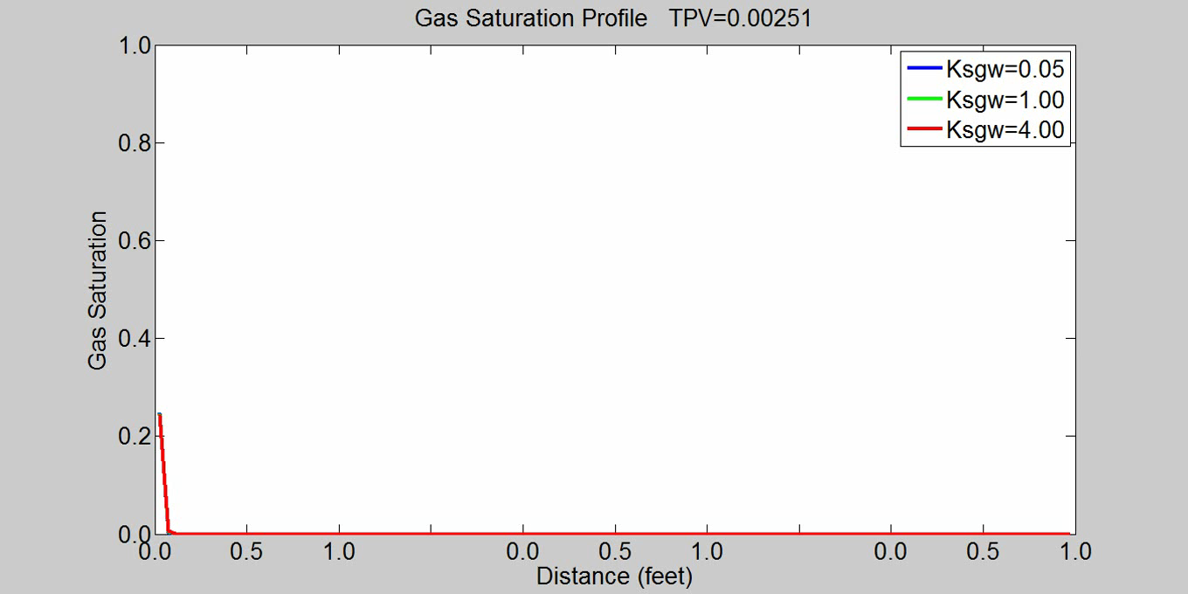
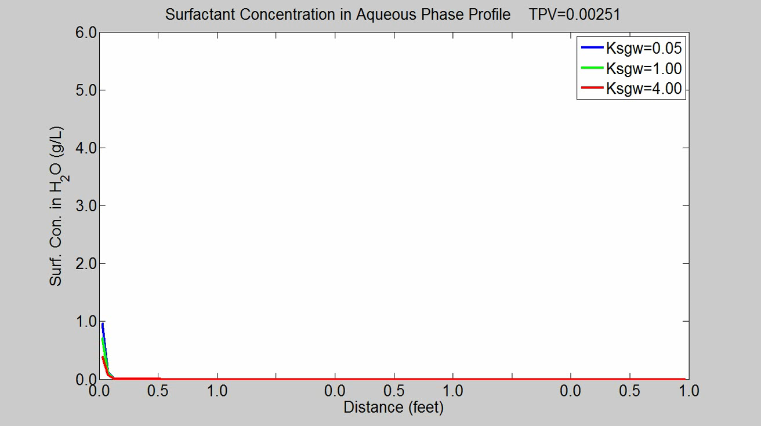

Slide 29
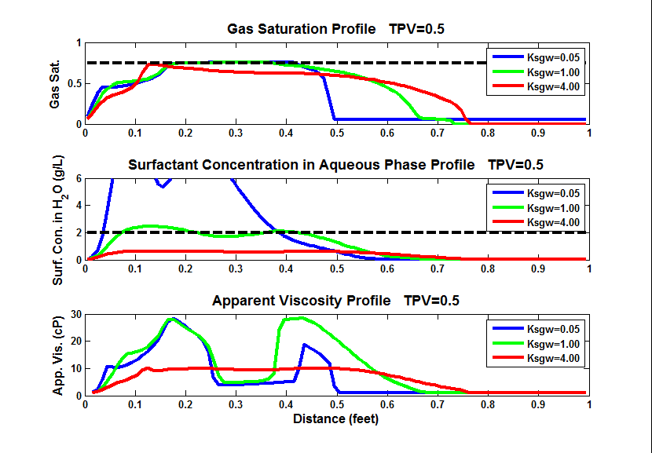
1-fmdry
fmsurf

Slide 30
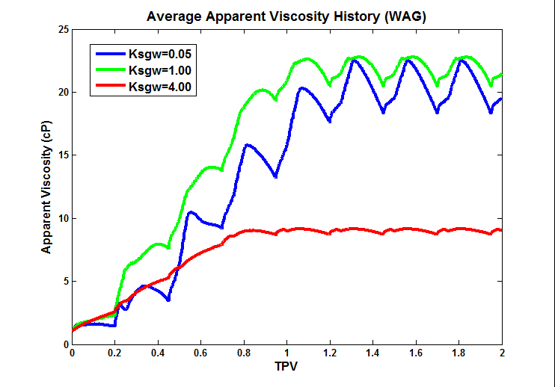

Slide 31
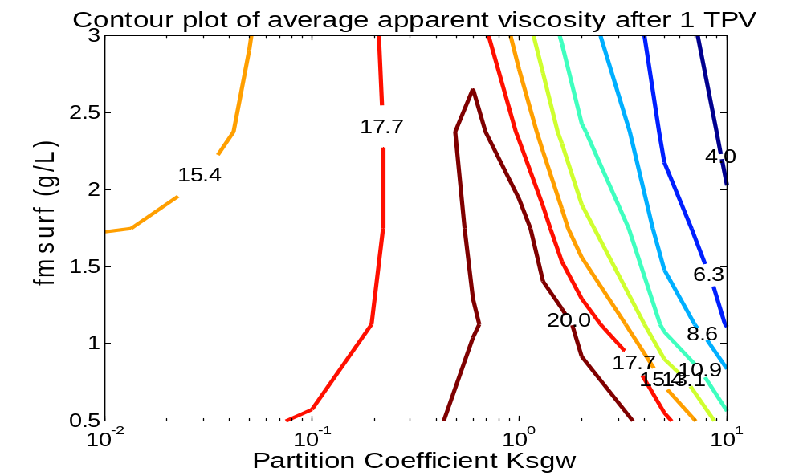
Effect of K_{sgw} and fmsurf
Given surfactant injection concentration (2.5 g/L in Gas Phase)
Given foam quality (f_{g,avg}=0.8)

Slide 32
Conclusion
K_{sgw} | Small | Large
Gas BT | Early | Late
Surf. Con. | Concentrated | Diluted
Surf. Transport | Retarded | Fast
Foam Transport | Slow | Fast
Foam Bank | Short | Long

Slide 33
Conclusion
Small partition coefficient will seriously retard surfactant and foam transport. Surfactant is highly concentrated in water which may cause problems like surfactant precipitation. When surfactant is stripped off into the water, gas mobility control will be lost.
Large partition coefficient will spread out the surfactant in a wide range and dilute the concentration. When surfactant concentration in aqueous phase drops below fmsurf, foam will be weaken.
Unity partition coefficient where surfactant is equally preferential to stay in CO₂ and water is favorable for CO₂ foam mobility control.
For a certain injection strategy and surfactant concentration, a smaller fmsurf will help to generate stronger foam (larger apparent viscosity).

Slide 34
Future Work
Include the effect of surfactant partitioning between aqueous phase and oleic phase when crude oil is present.
The influence of surfactant partitioning and fmsurf in a 2-D or 3-D heterogeneous system with the presence of gravity segregation and fractures.
Notes:
In the future we can do…

Slide 35
References
Ren, Guangwei, Hang Zhang, and Quoc P. Nguyen. “Effect of Surfactant Partitioning Between CO2 and Water on CO2 Mobility Control in Hydrocarbon Reservoirs.” SPE: Society of Petroleum Engineers, 2011. doi:10.2118/145102-MS.
Ma, Kun. (2013) "Transport of Surfactant and Foam in Porous Media for Enhanced Oil Recovery Processes." Doctoral Thesis, Rice University. http://hdl.handle.net/1911/71996.

Slide 36
Acknowledgement
This work was financially supported by
Rice University's
Consortium for Processes in Porous Media

Slide 37
Thank you

